Slide 1





Database Fundamentals And
Microsoft Access
For Beginners
4 Logical Design
Prepared By :
Said Fawzy
Manager of Information Center
Tendering Department
Arab Contractors

Slide 2
Contents
ERD Mapping to tables
create tables in MS access
Database Constraints

Slide 3



Slide 4
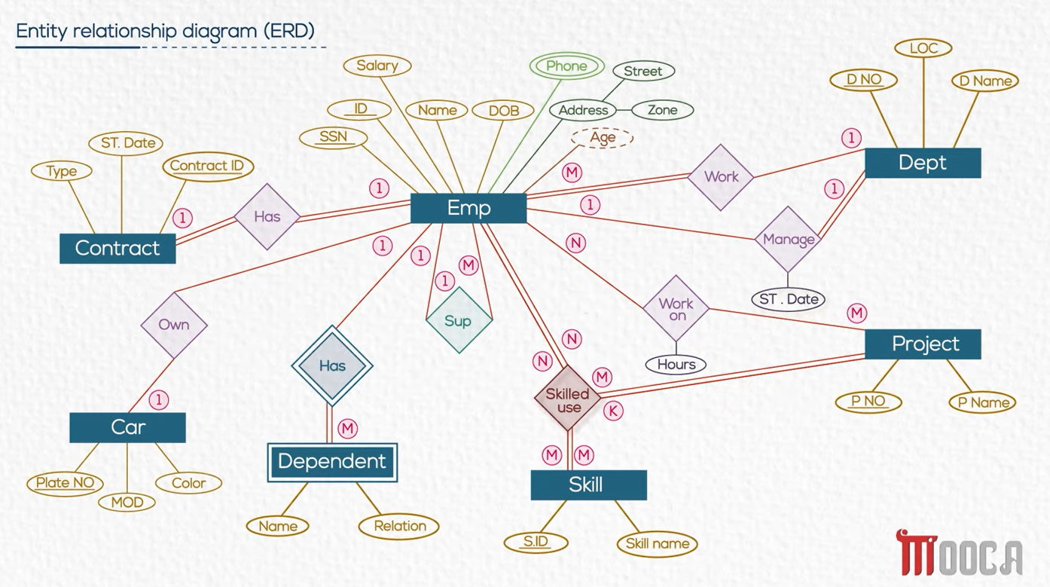


Slide 5
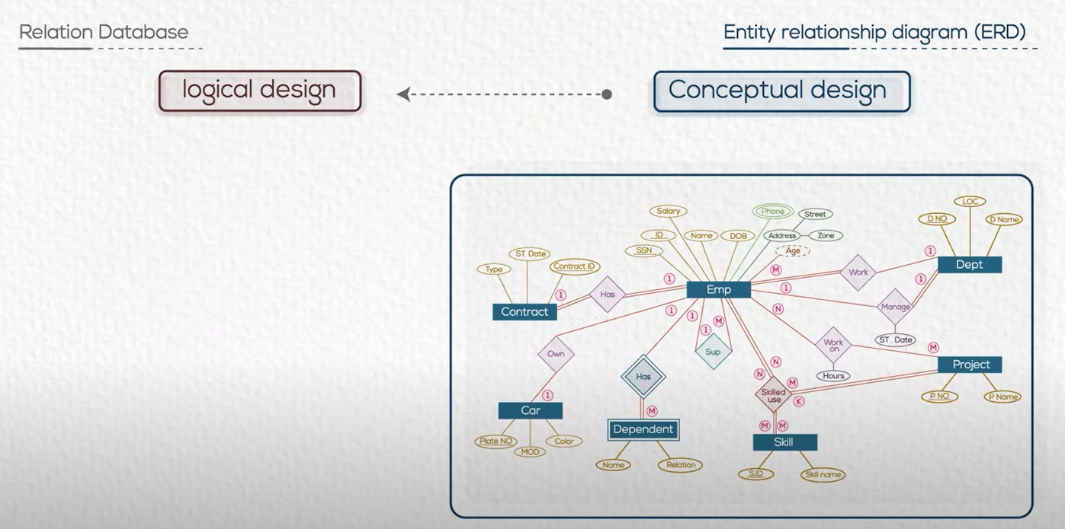

Slide 6
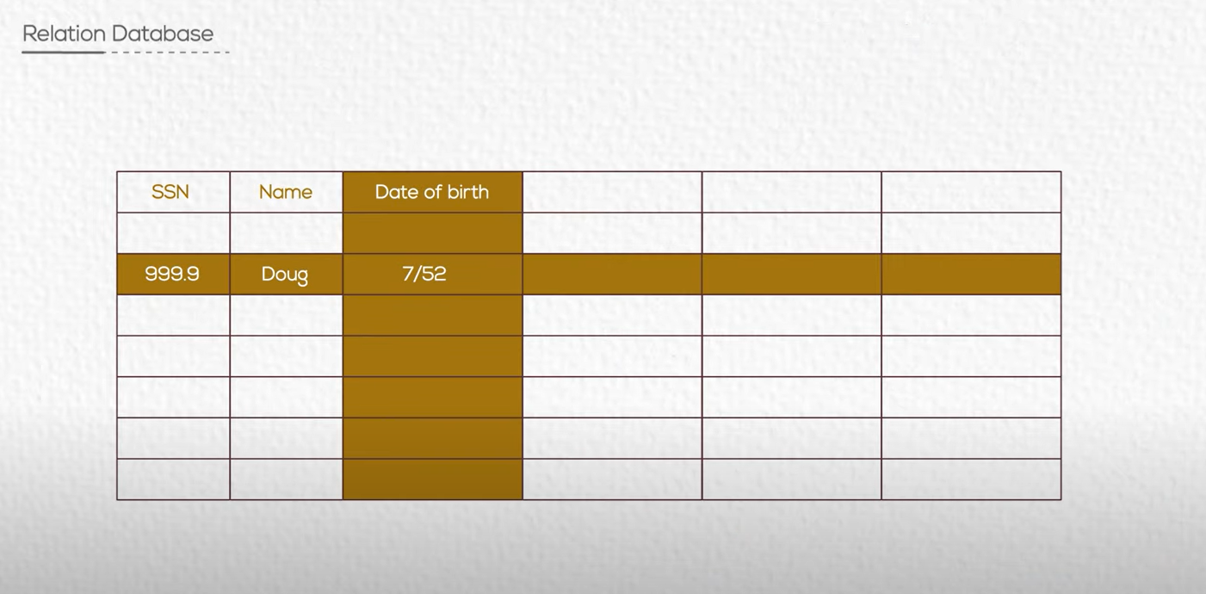
Relational DB is a group of tables

Slide 7
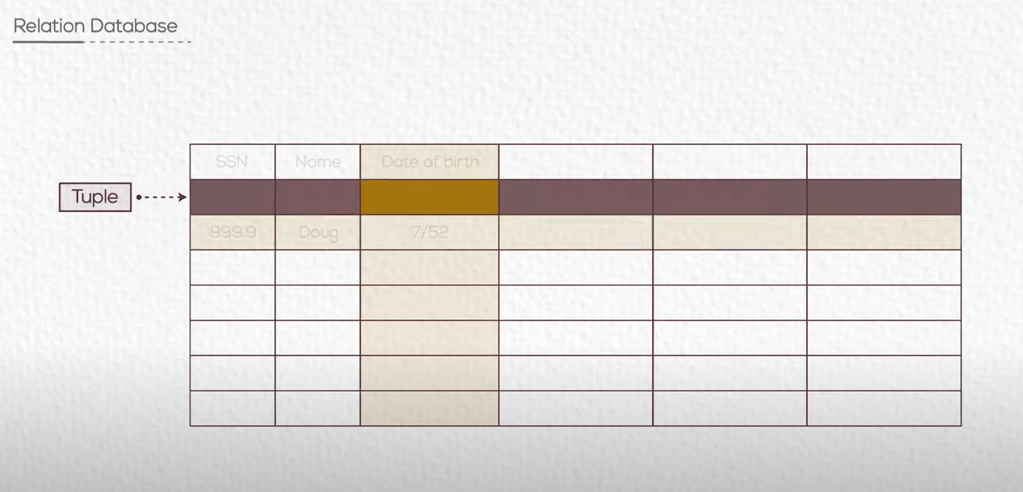


Slide 8
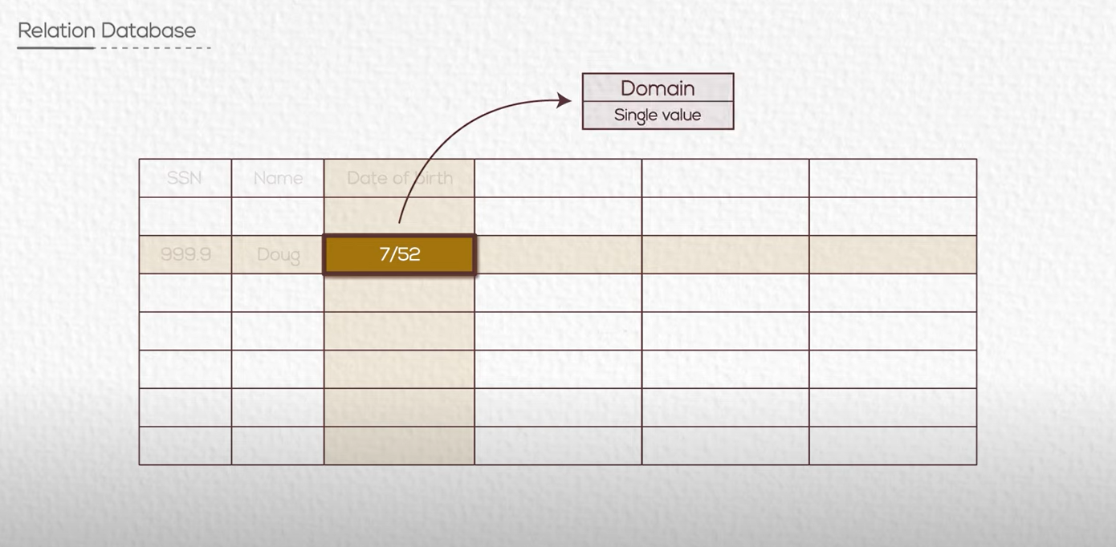

Slide 9
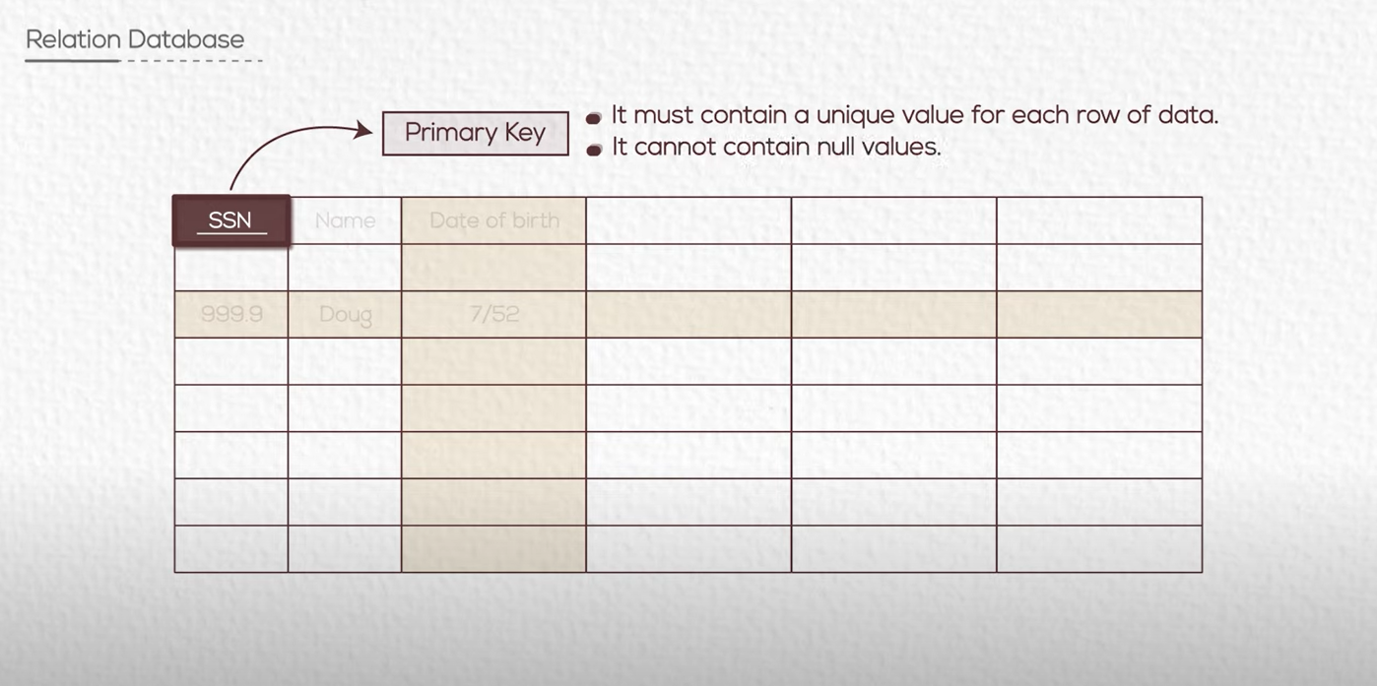

Slide 10
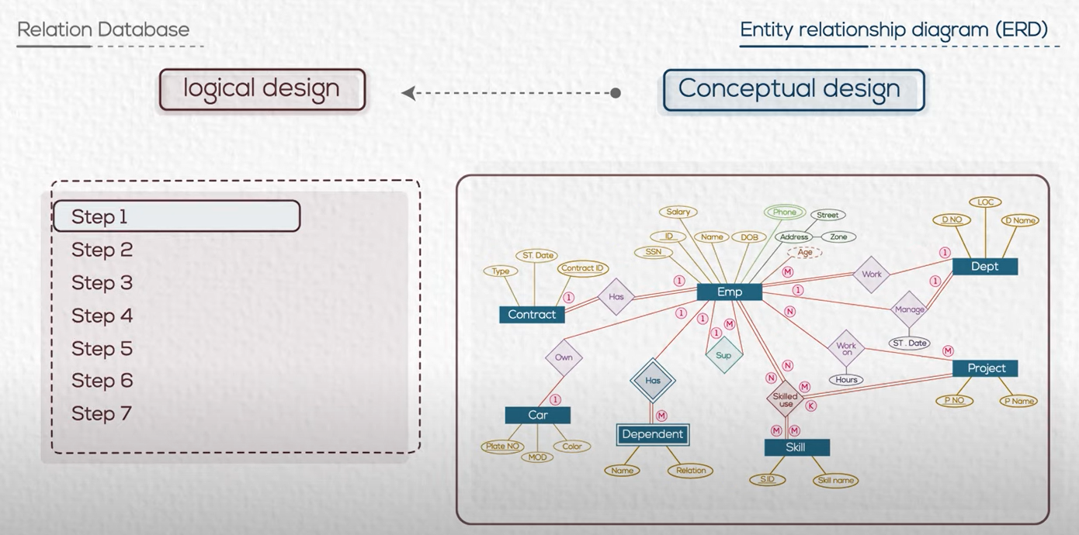
Follow some rules to convert to logical design

Slide 11

Task 5 : ERD Mapping to Tables
We need to convert our conceptual model into logical model

Slide 12
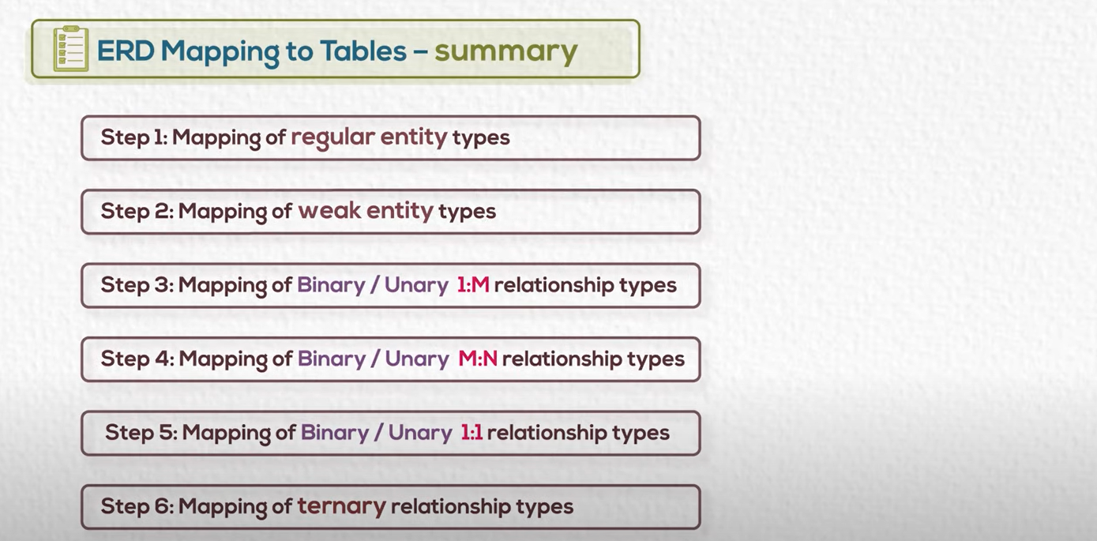

Slide 13
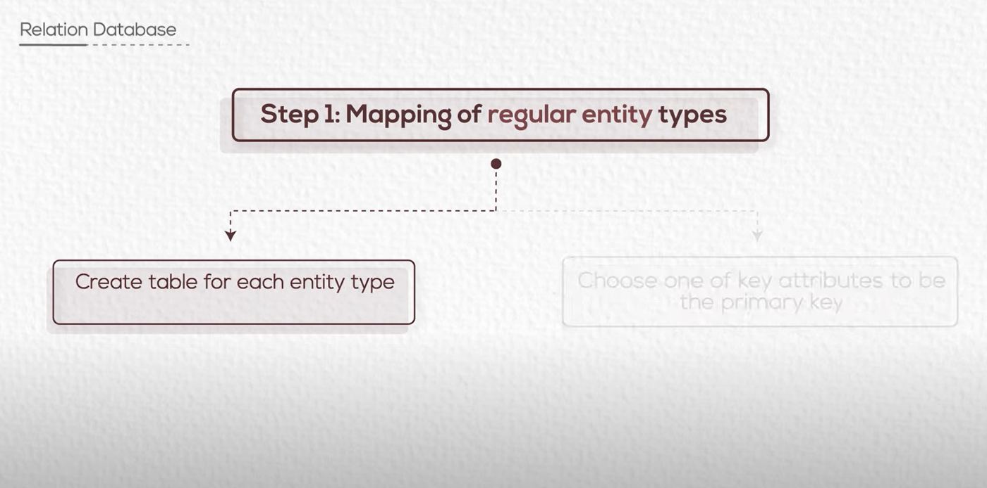

Slide 14
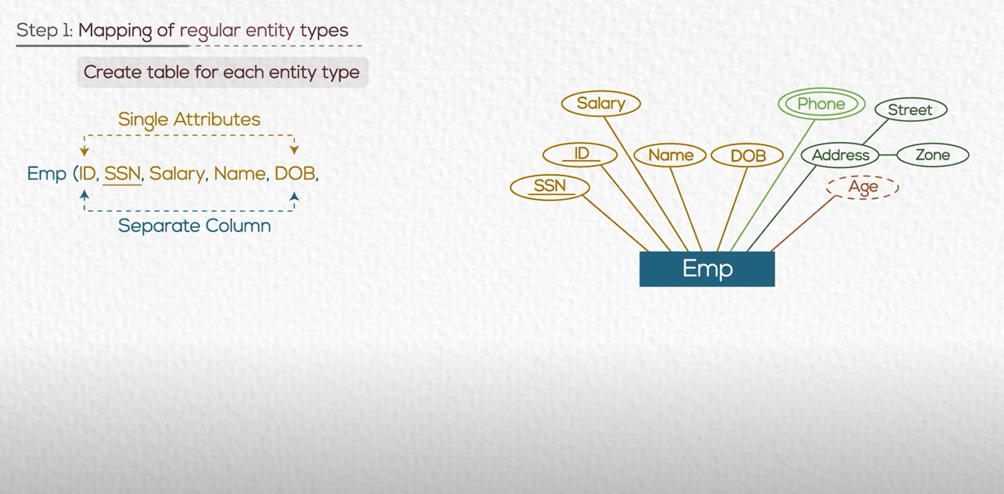
Single attribute map to one column

Slide 15
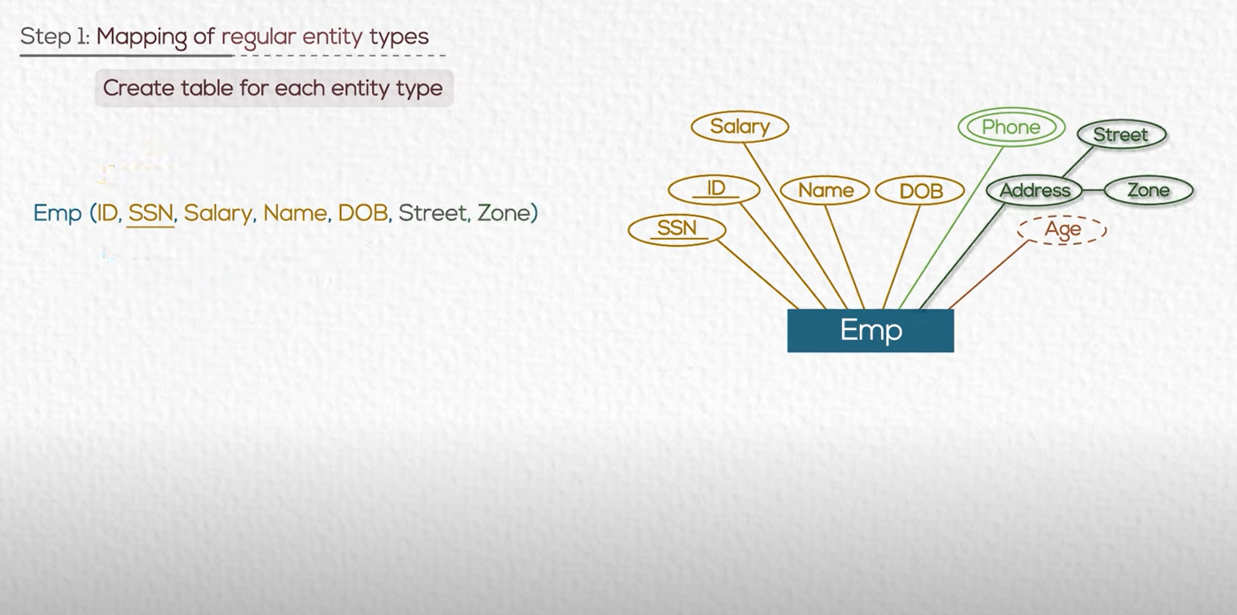
compost attribute map to columns for each

Slide 16
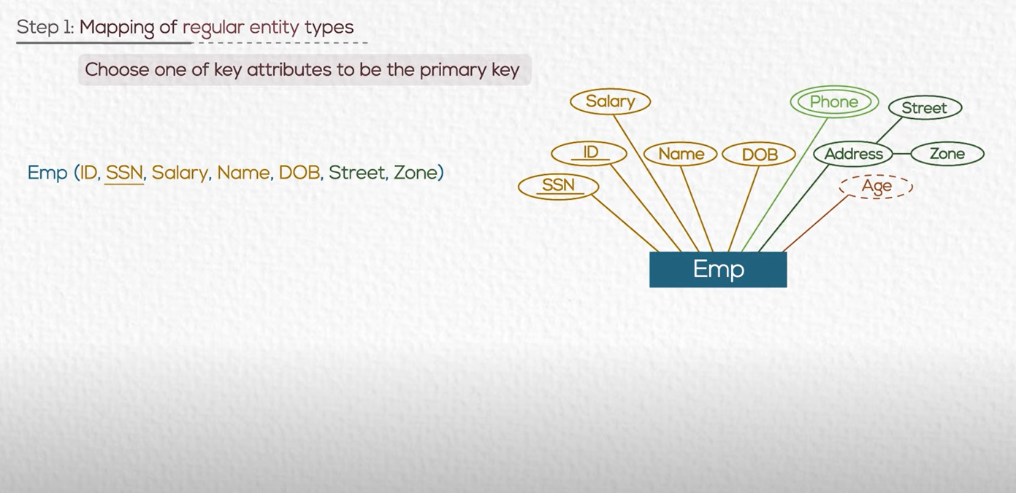

Slide 17
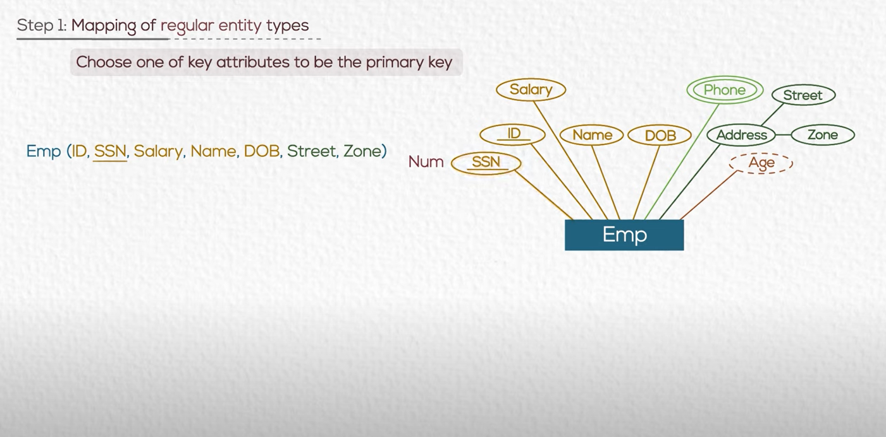
text
underline
We chose the less in storage if we have two candidates

Slide 18

Multi Valued attribute
Now we have problem for phone
As it is a Multi Valued Attribute

Slide 19
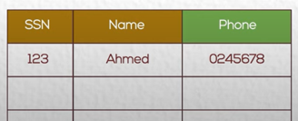
Multi Valued attribute
Ahmed has more than one phone
BUT …..Domain has only single value
What should we do ?

Slide 20
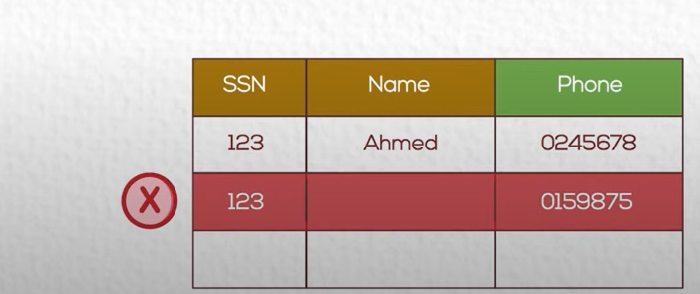
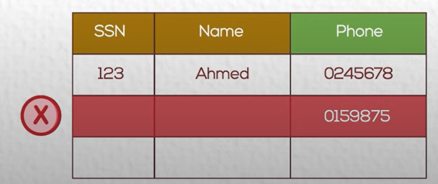
Multi Valued attribute
Breaking the rule of primary key.
No Duplicate
Breaking the rule of primary key.
PK can not be Null

Slide 21
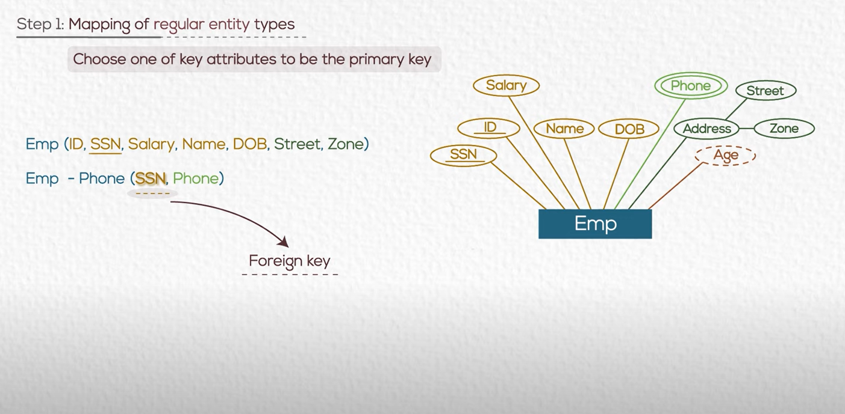
Solution :
Let Phones in separate table
Use a foreign key
A FK is a value reference PK in another table.
FK must have value in the main table as PK

Slide 22
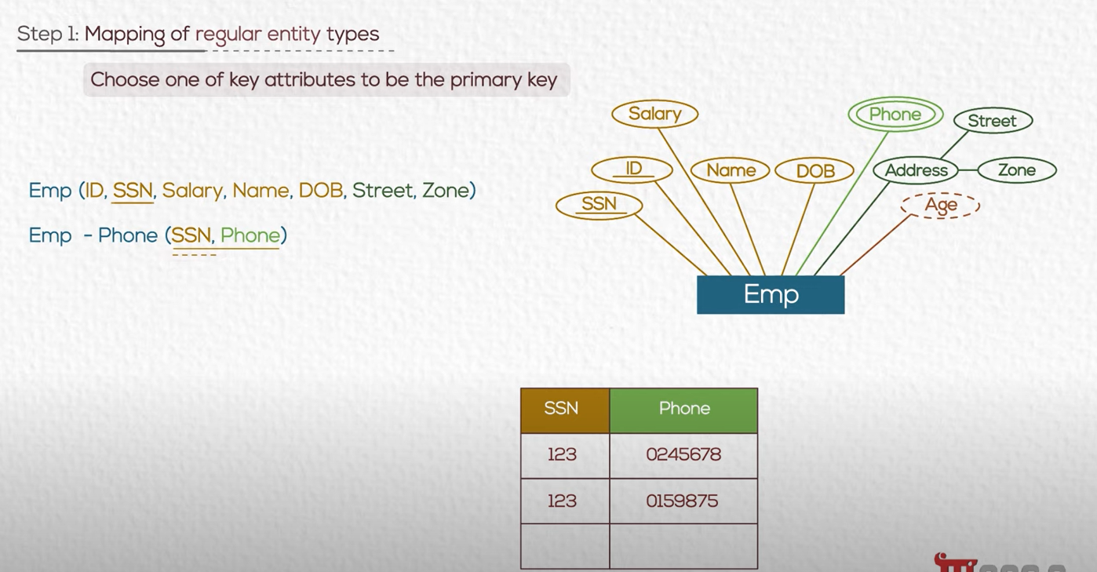
Solution :
PK of the Emp-Phone table is a composite Primary key (SSN , Phone)

Slide 23
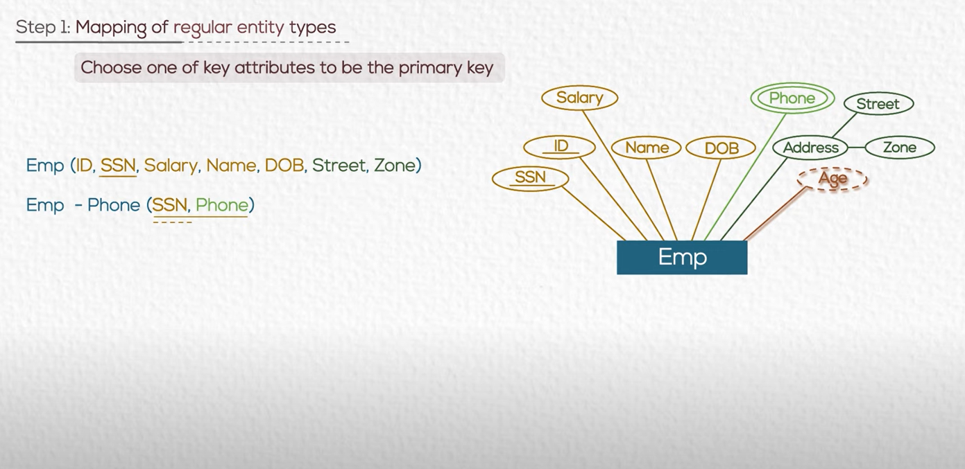
Derived attribute
We do not store value of Age as it is a calculated field.
It affects the performance of DB.
If we need it so much we can save it in a field.

Slide 24
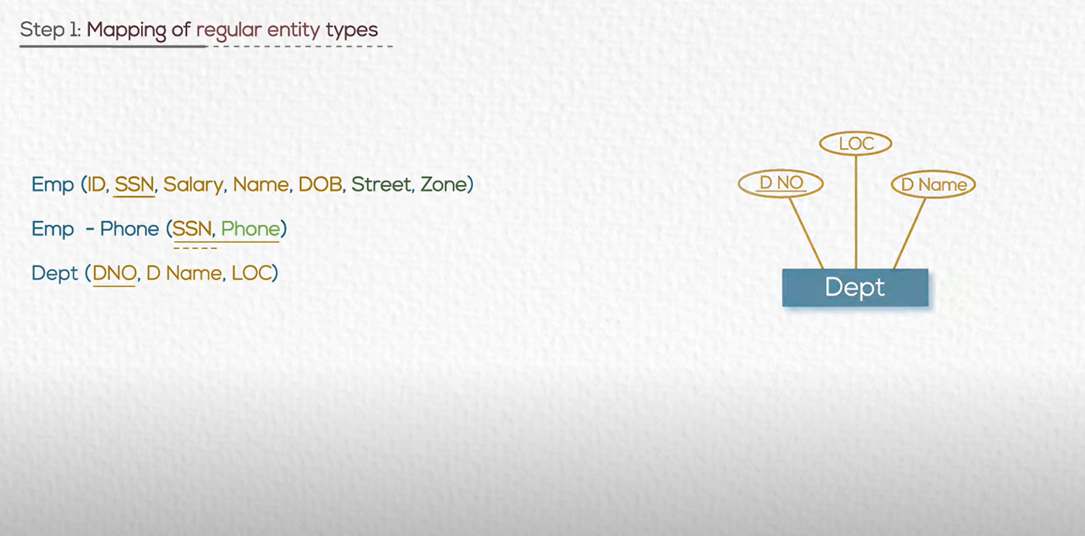

Slide 25
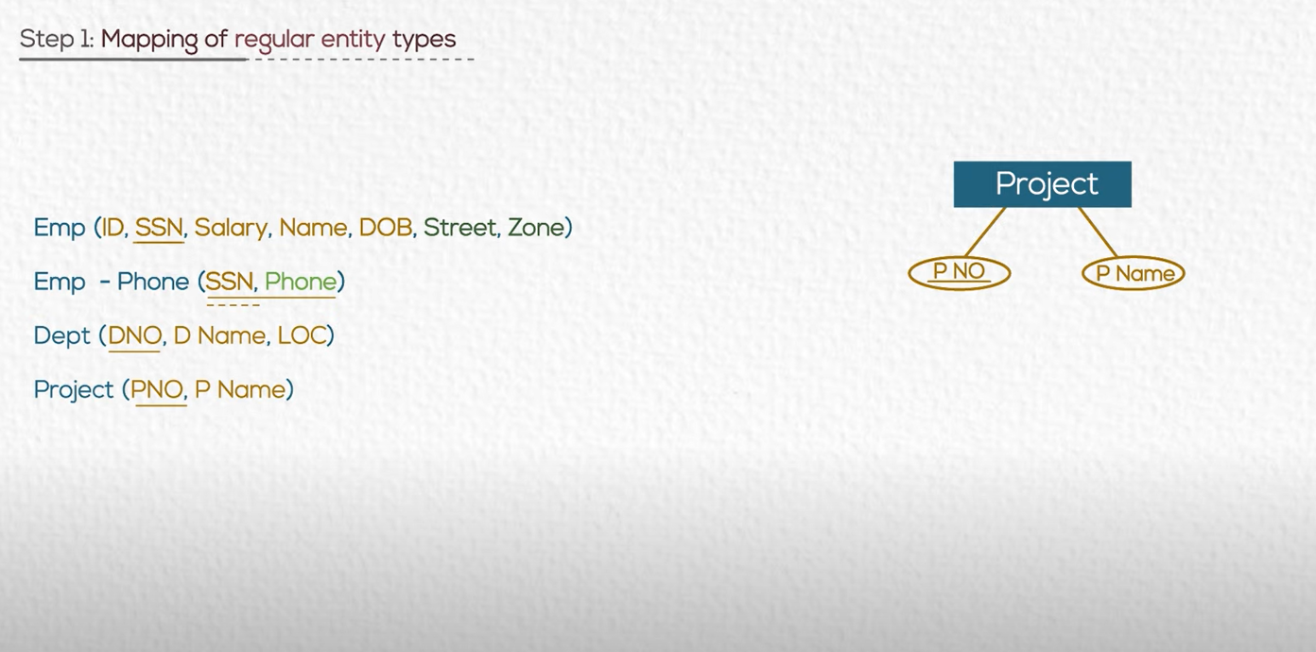

Slide 26
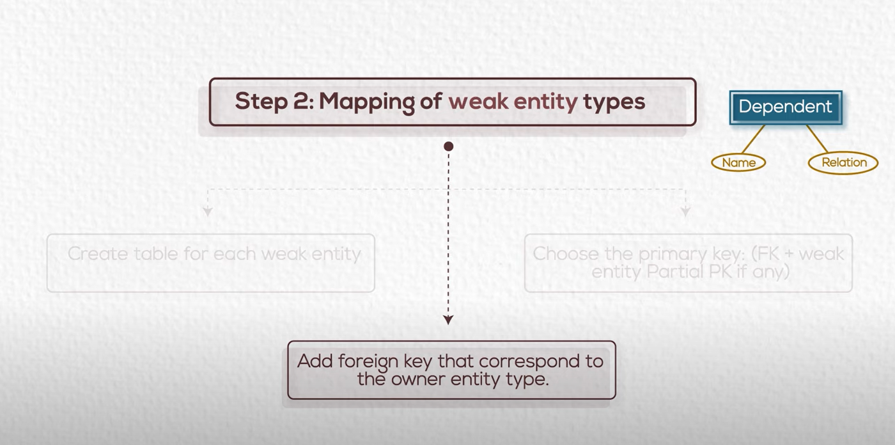

Slide 27
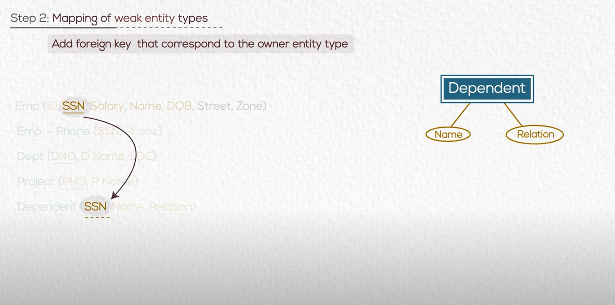
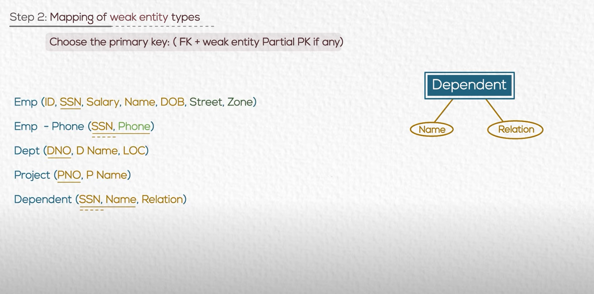

Slide 28
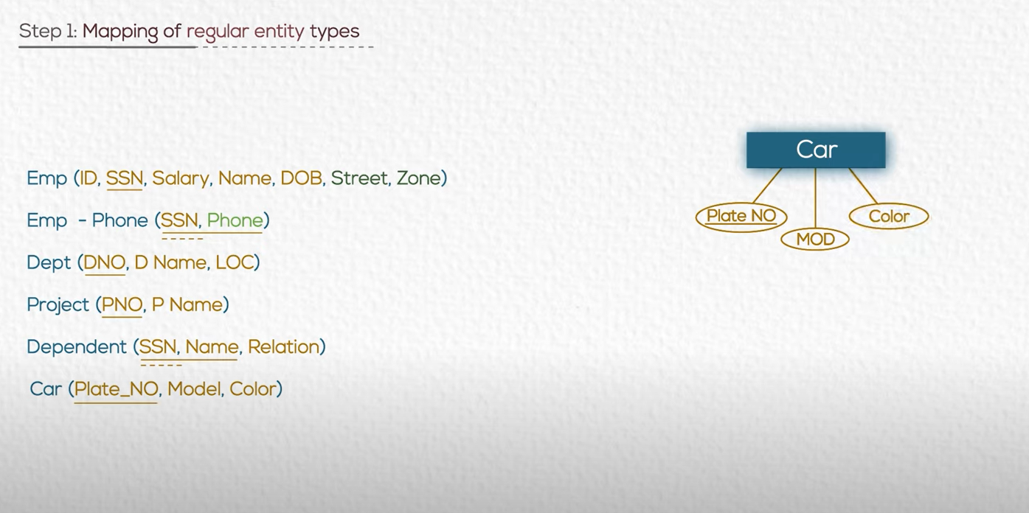

Slide 29
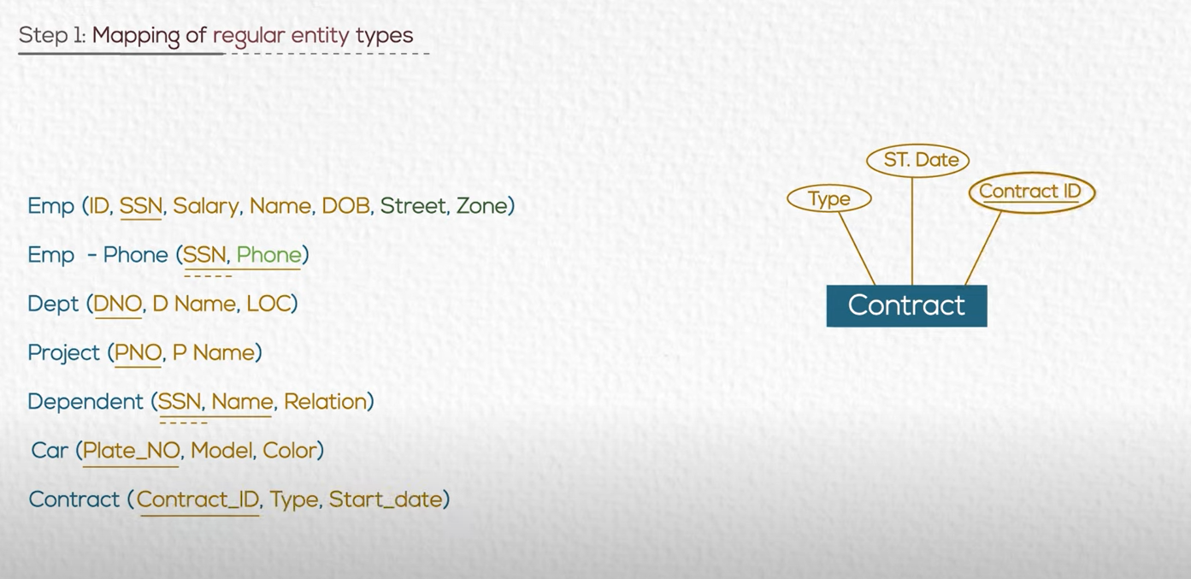

Slide 30
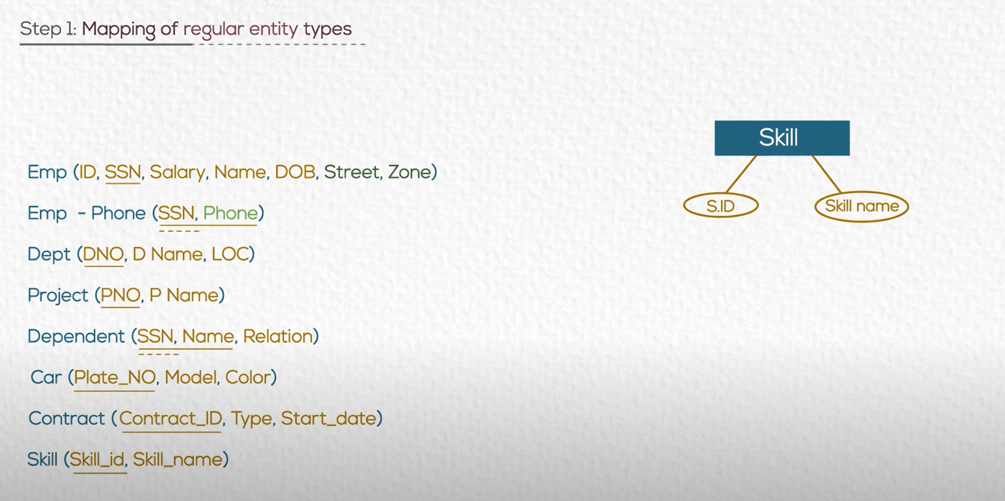

Slide 31



Slide 32
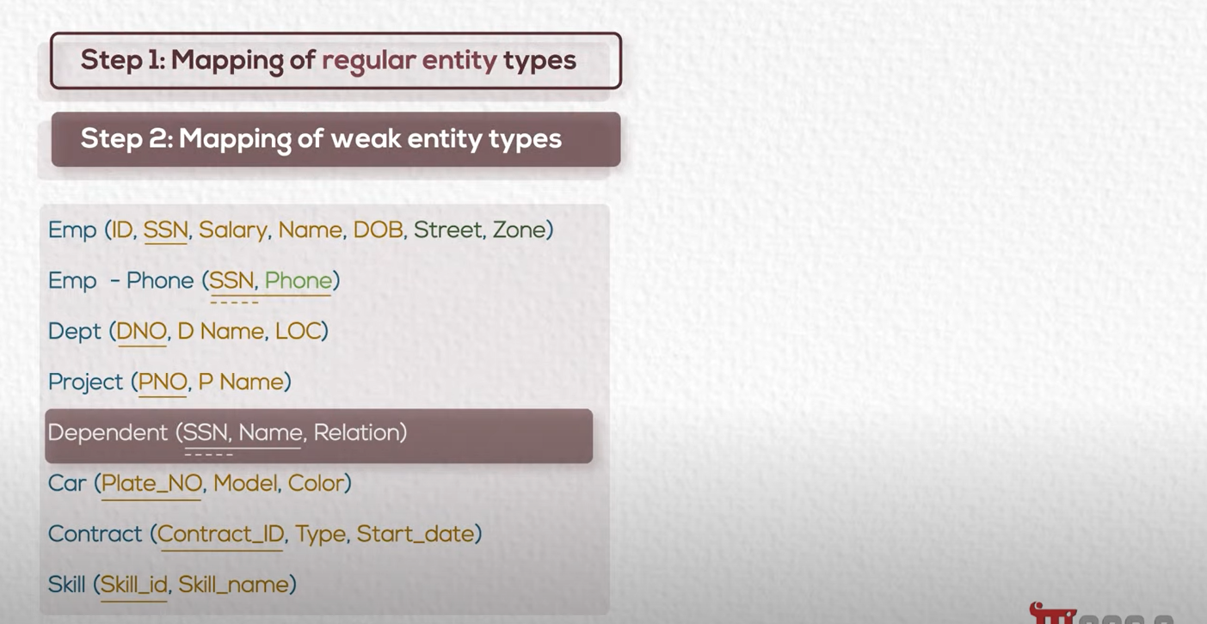

Slide 33
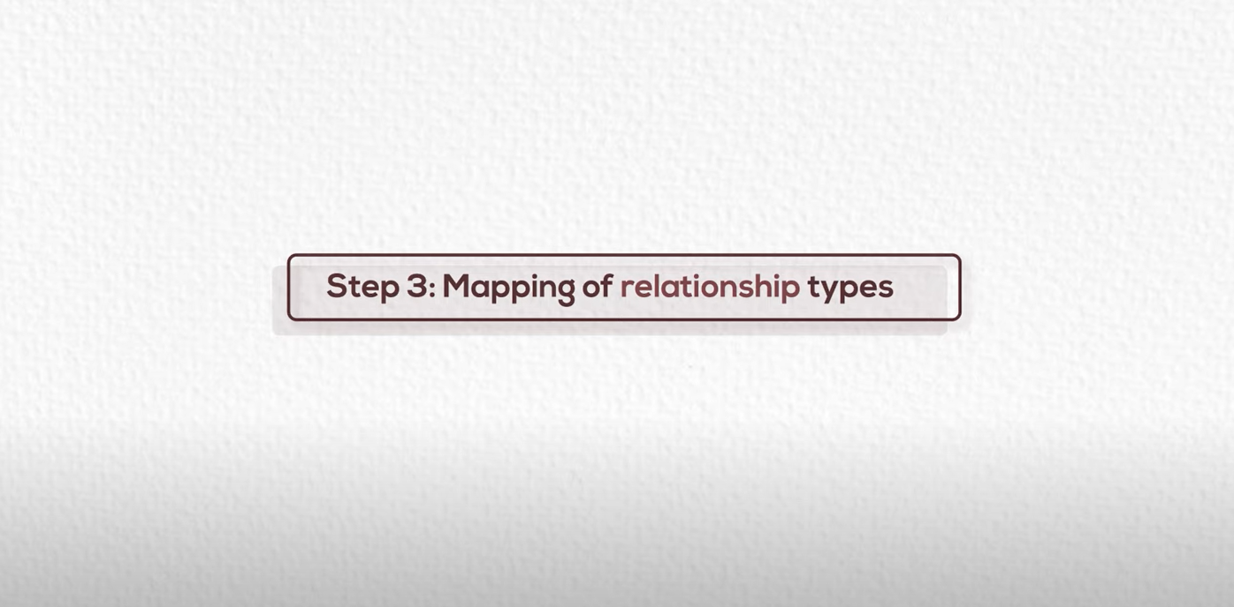

Slide 34
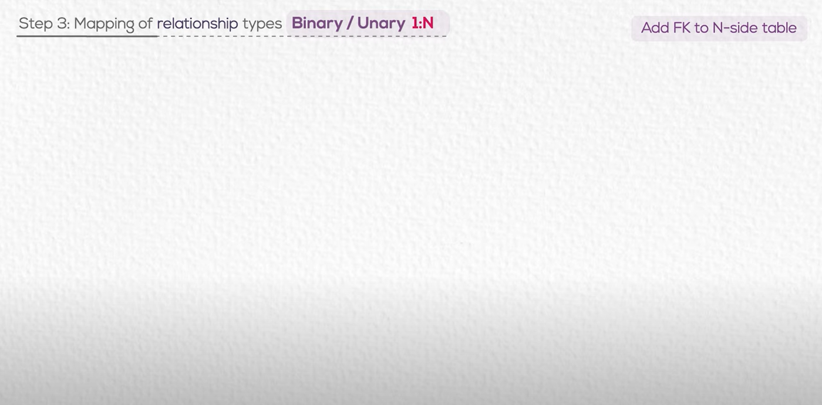

Slide 35
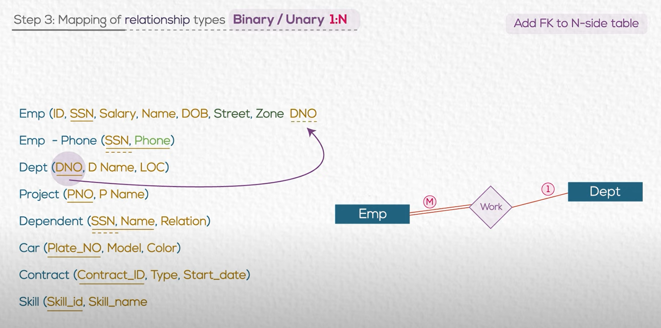

Slide 36
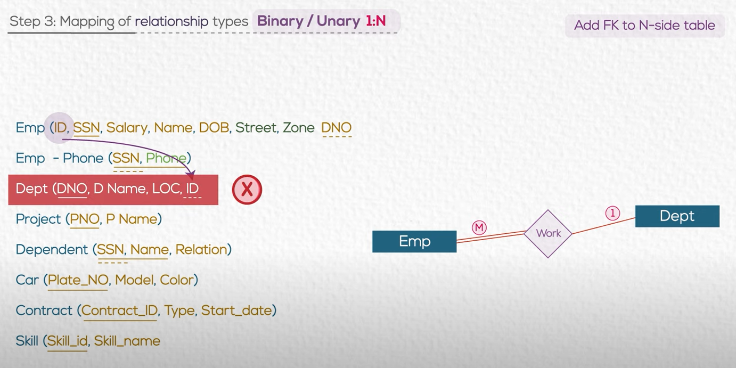
JUST TAKE CARE

Slide 37
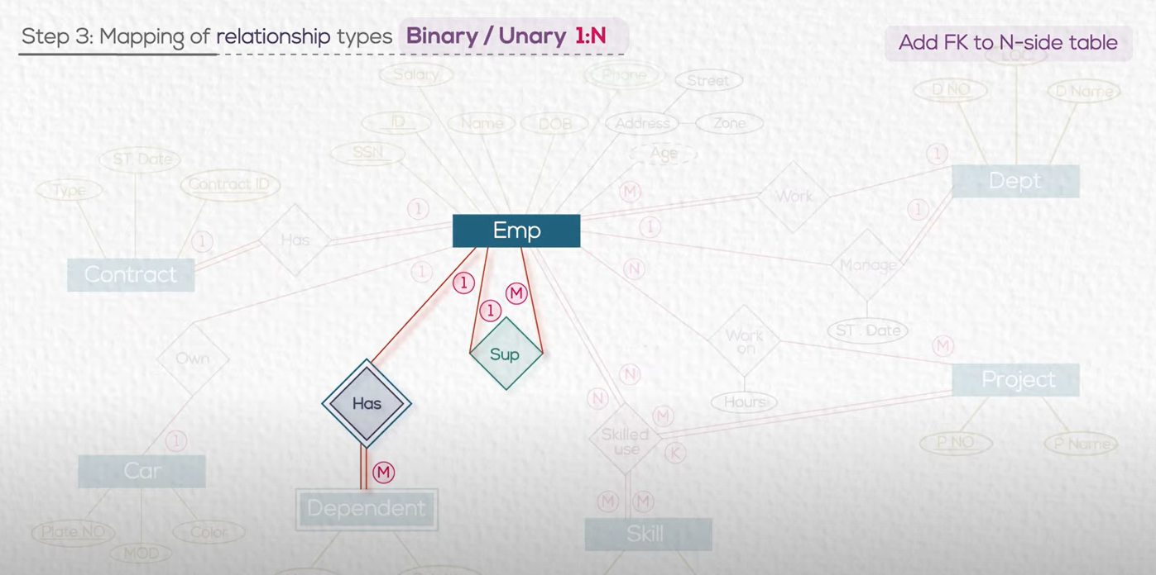

Slide 38
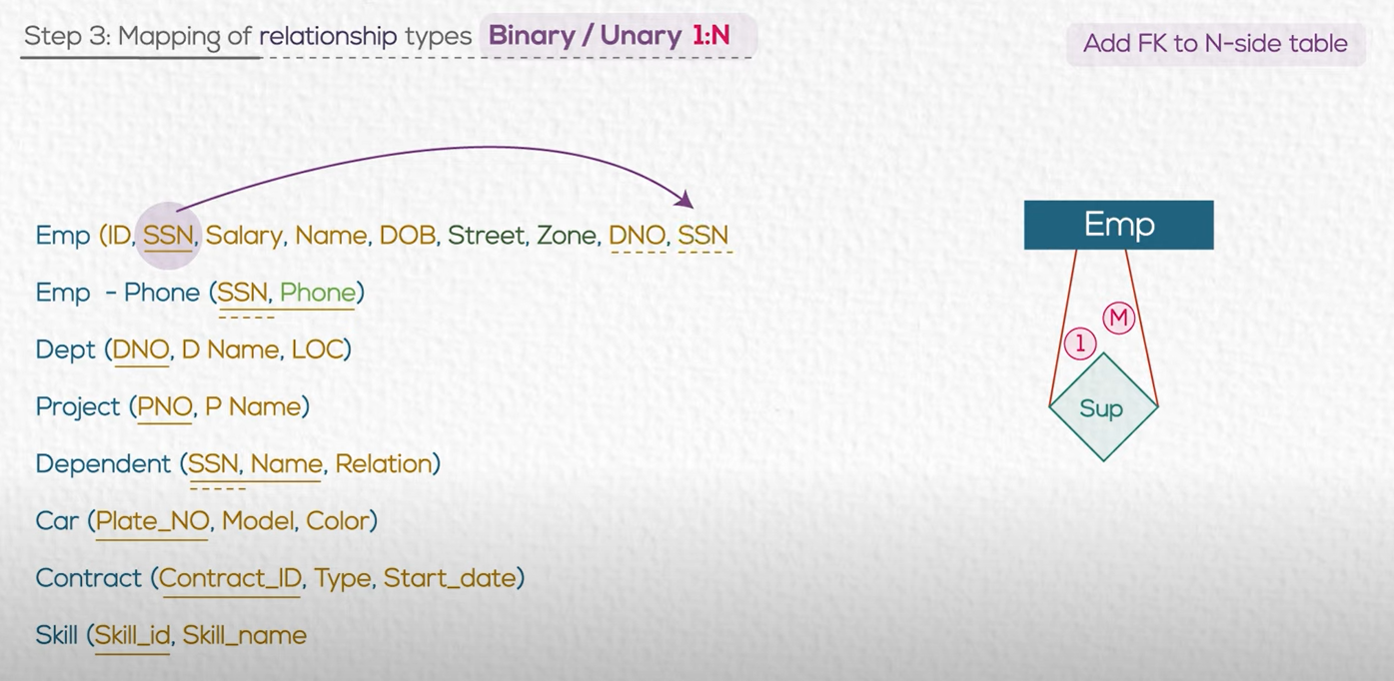

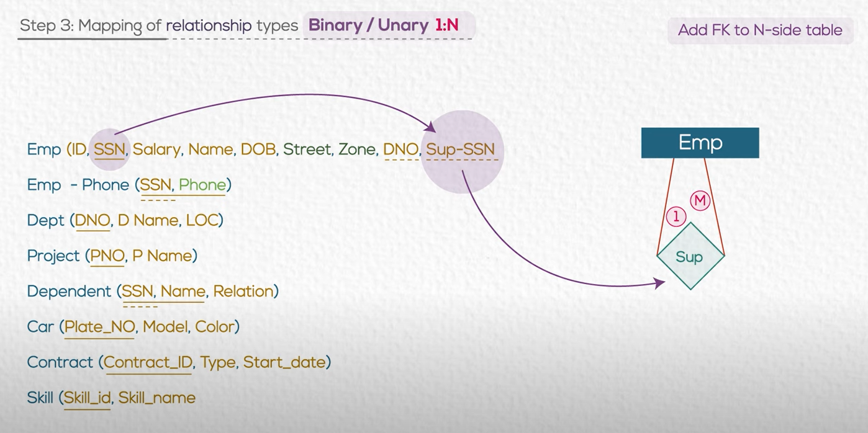

Slide 39
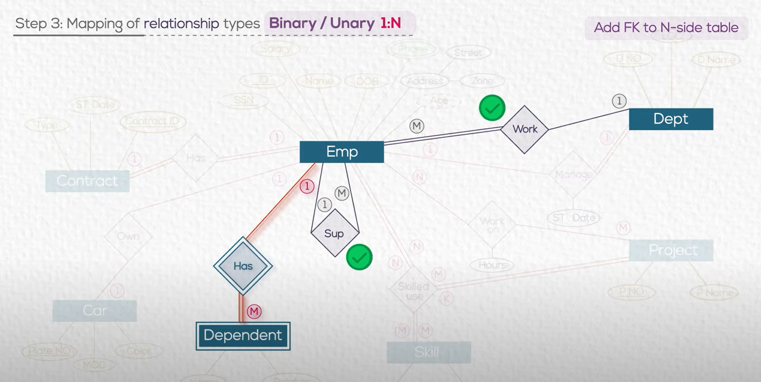

Slide 40
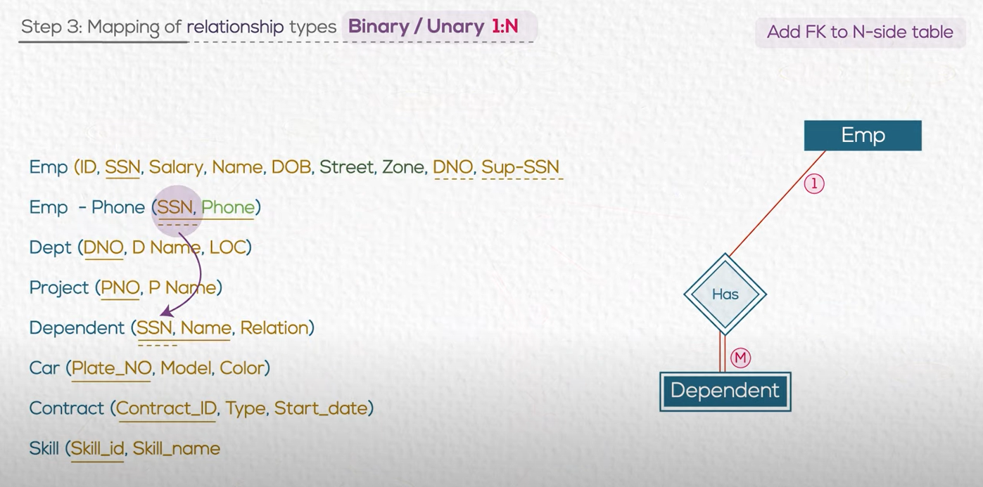
I have already did that

Slide 41

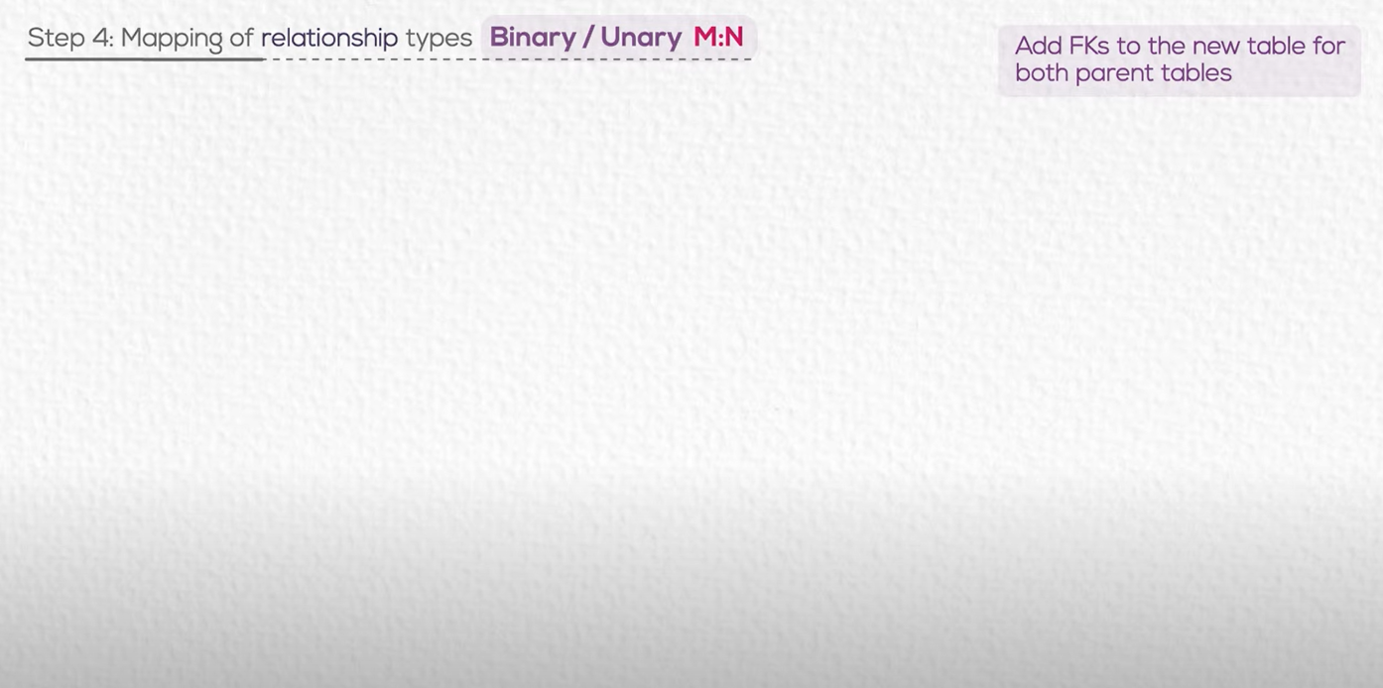

Slide 42
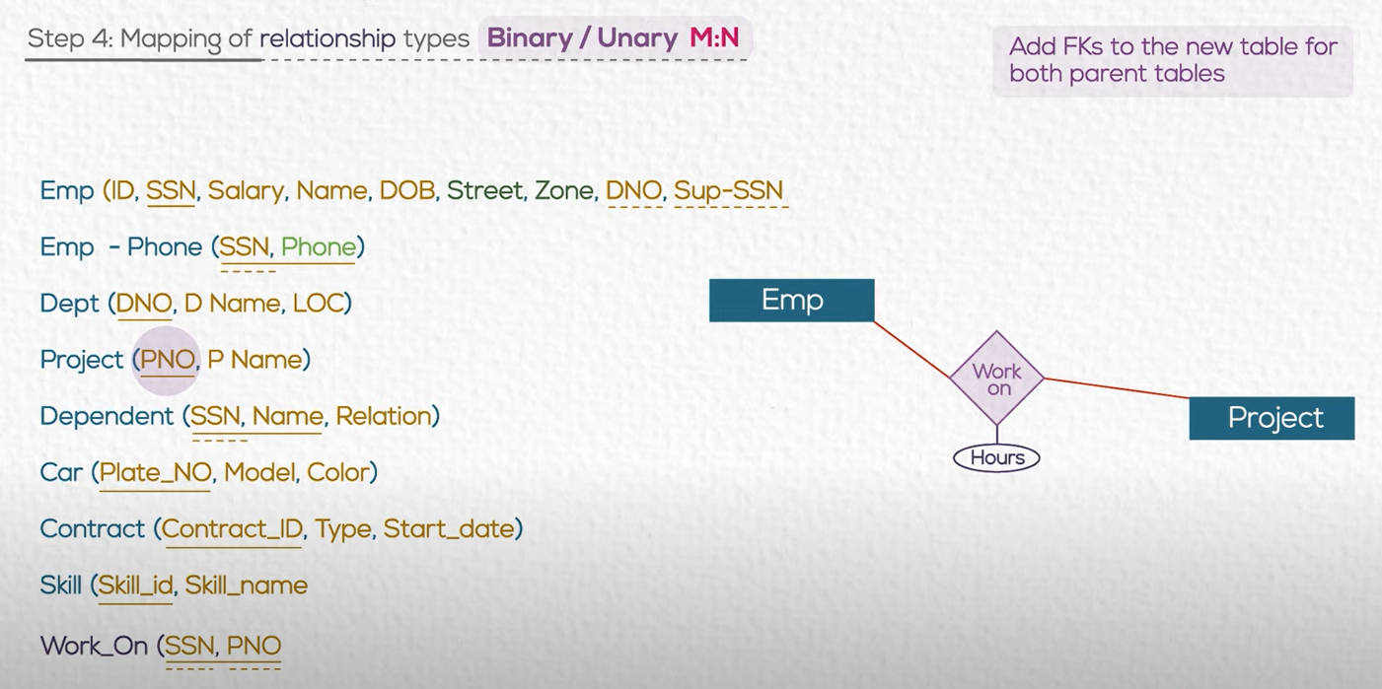

Slide 43
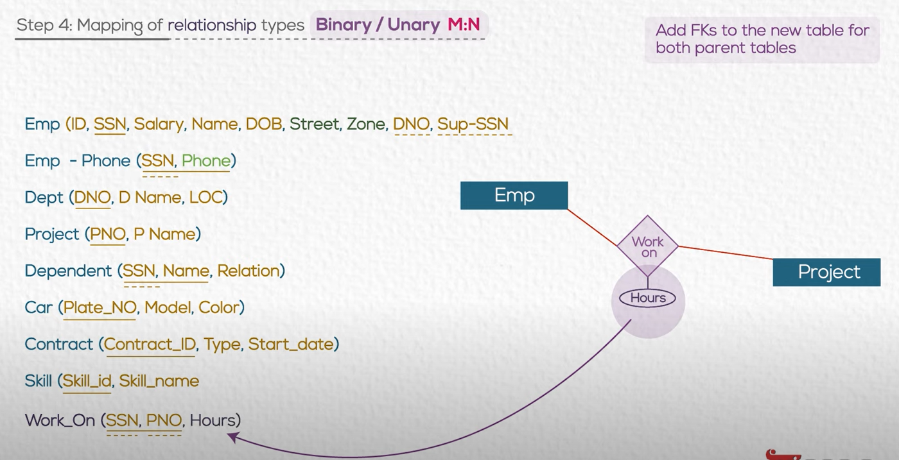
Attribute in the relation follow the foreign key

Slide 44
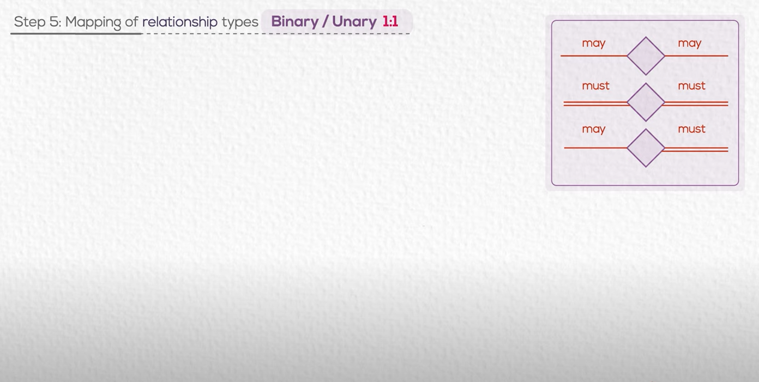

Slide 45
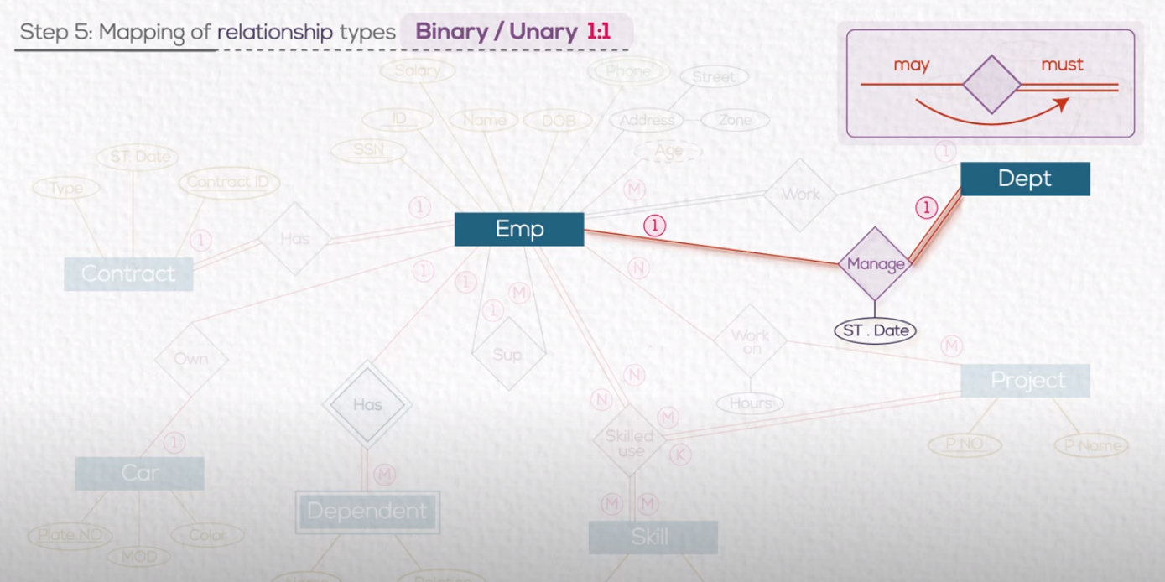
PK from MAY is FK in MUST

Slide 46
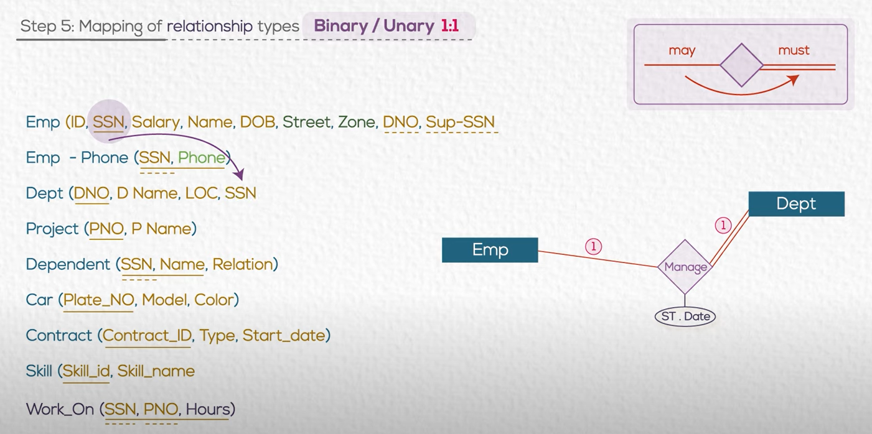
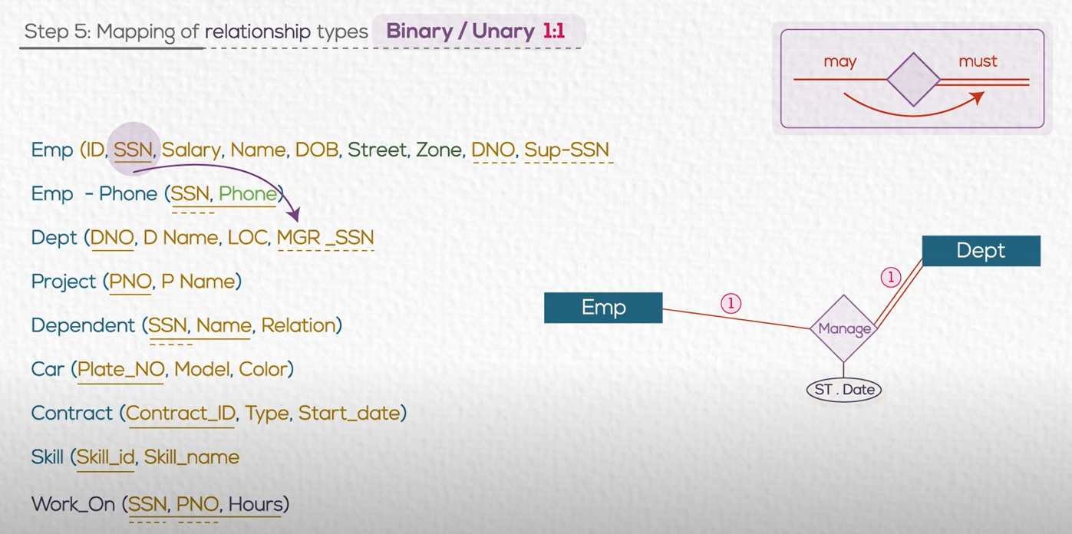

Slide 47
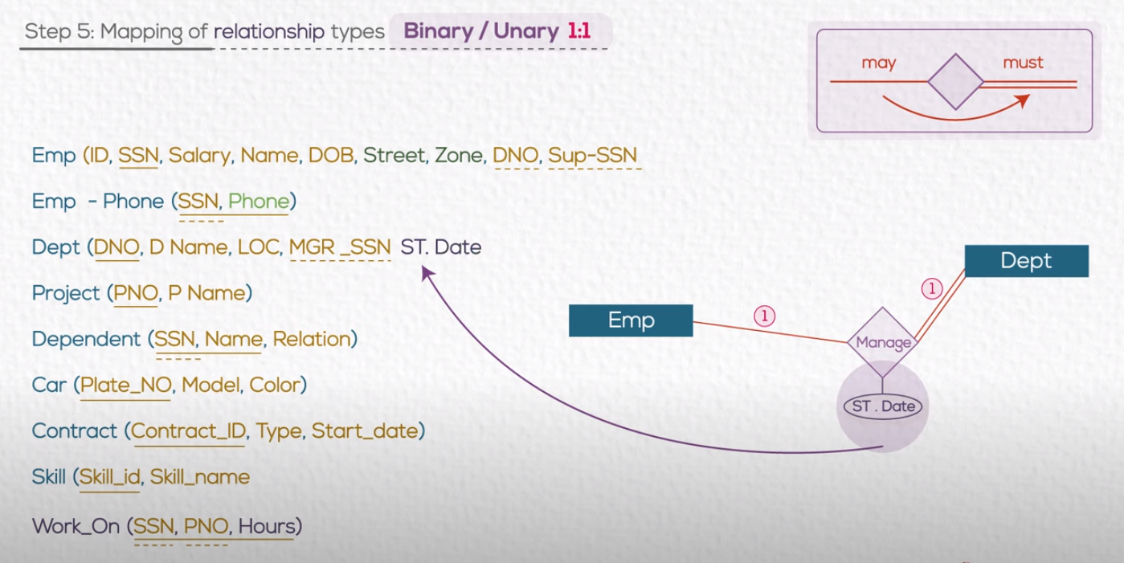
Remember : Attribute in the relation follow the foreign key

Slide 48
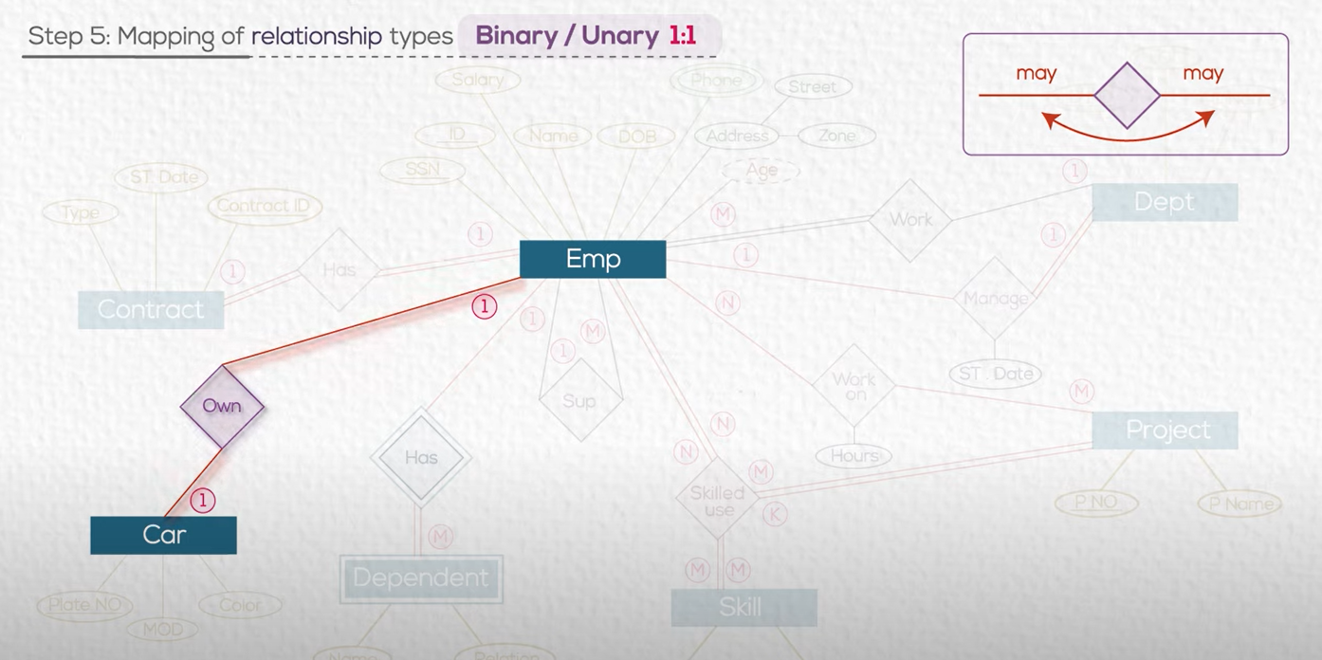
We have 3 options

Slide 49
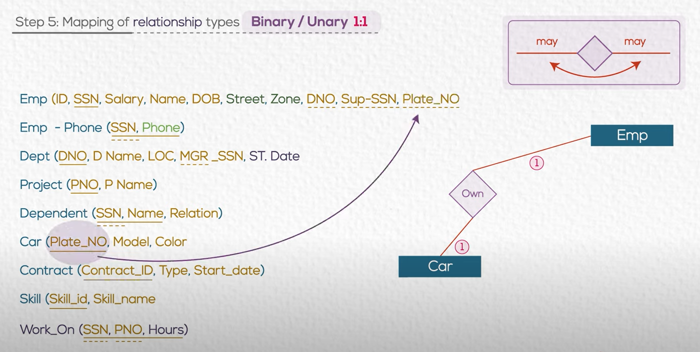
Solution 1

Slide 50
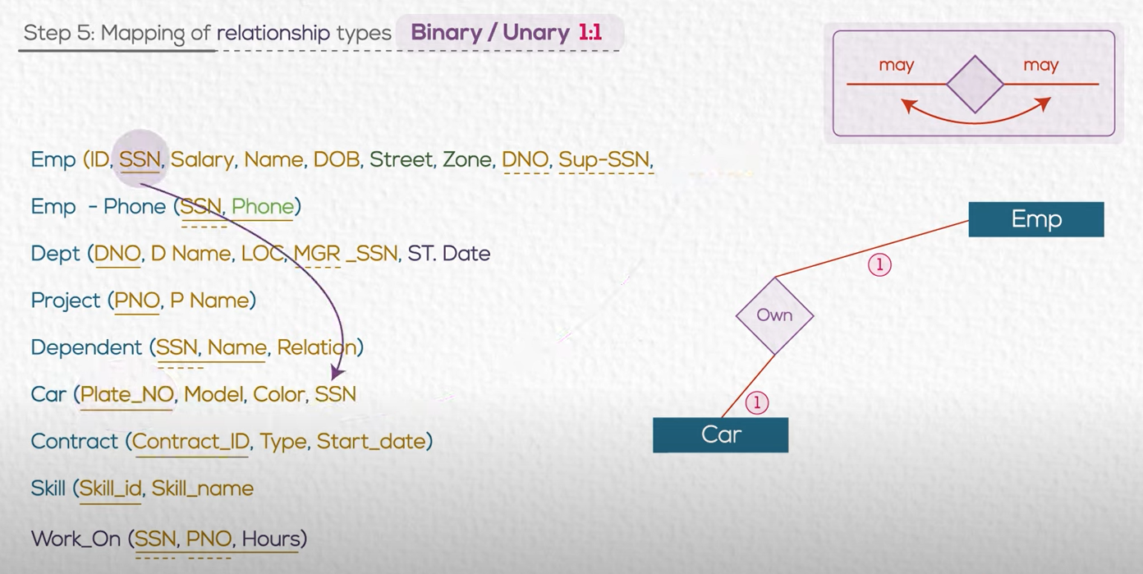
Solution 2

Slide 51
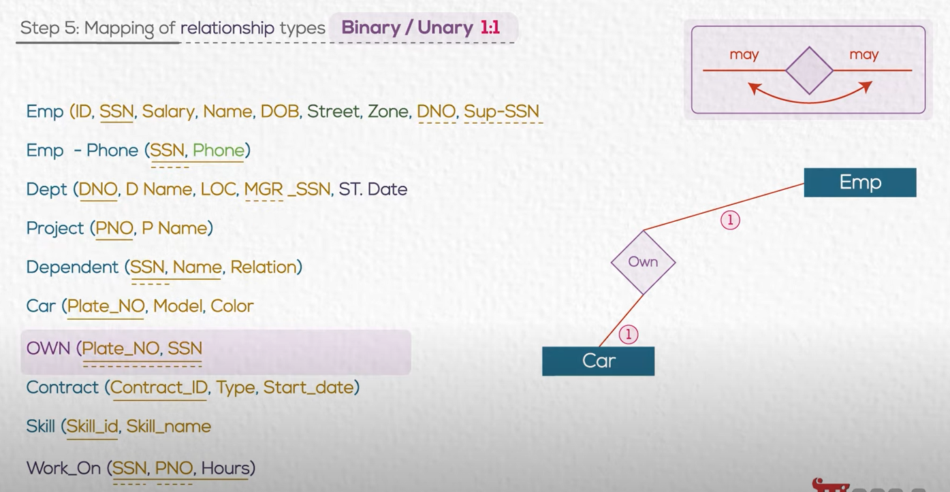
Solution 3

Slide 52

Recommended

Slide 53
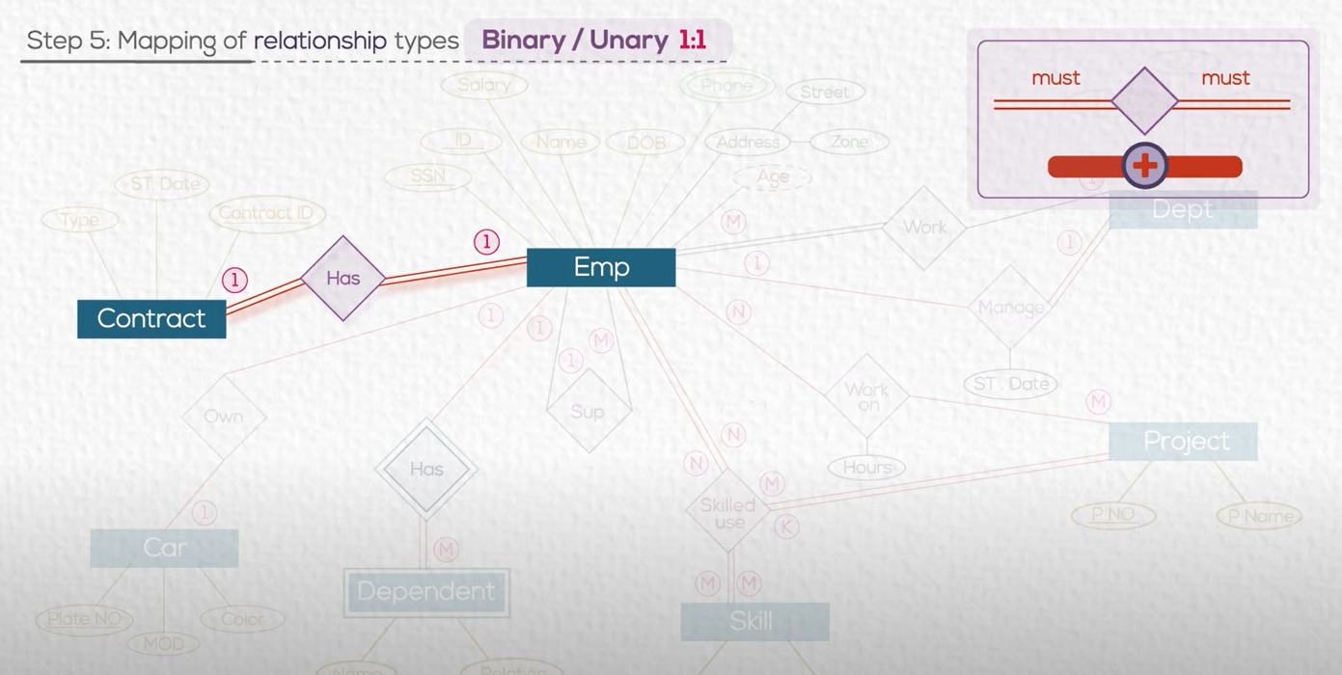

Slide 54

Solution : Merge the two tables

Slide 55


Slide 56

You can use any of the PK of the two tables as PK for the new merged one

Slide 57


Slide 58

Create new table

Slide 59

Add FKs to the new tables for all parent tables.

Slide 60


Slide 61
Summary

Slide 63

Simple(single) attributes.

Slide 64


Slide 65


Slide 66


Slide 67


Slide 68


Slide 69


Slide 70

1:M

Slide 71


Slide 72


Slide 73

We check the participation

Slide 74


Slide 75

Attributes on relations always follow the FK

Slide 76

Relationship Diagram

Slide 77




Slide 81



Slide 83
Relationship Diagram

Slide 84
Activity 3: ERD to Tables
• Use your conceptual model in activity to and convert them into tables

Slide 86






Slide 87


Slide 88


Slide 89


Slide 90


Slide 91





Slide 92


Slide 93

Referential Integrity works when insert or delete

Slide 94

We insert first a parent record then the child one : (we have dept with ID=100 and then we say the employee is in Dept 100)

Slide 95

FK works as a pointer to its parent

Slide 96

If you want to delete parent (department),
You must first delete children (records for its employees)

Slide 97


Slide 98


